Slide 2
In October 2017,
delegates from the 83 Jesuit provinces worldwide,
representing 2,320 Jesuit schools
with 2,197,000 students
on six continents,
gathered in Rio de Janeiro,
for the first time in the 450-year history of the Society of Jesus,
to consider how our global network of schools
could be better adapted and used
for the greater glory of God
and the common good.

Slide 3
Jesuit education – A 450-year old tradition of innovation
1548
First Jesuit school
founded at Messina
in Sicily
1593
English Jesuit College
(today Stonyhurst College)
founded at St Omer
1599
Ratio Studiorum
The Jesuit Plan of Studies
1773
Suppression of the Society
and the closure of Jesuit schools and universities
1814
Restoration of the Society and its schools
1986
The Characteristics
of Jesuit Education
2017
International Congress of
Jesuit Schools
Rio de Janeiro
1993
Ignatian Pedagogy
The Jesuit Method of
Teaching and Learning
2013
Jesuit Pupil
Profile

Slide 4
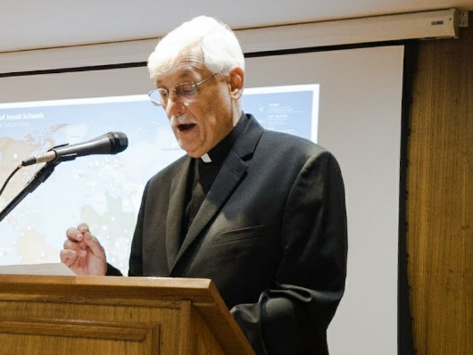
The Congress was addressed by Fr Arturo Sosa, Superior General of the Society of Jesus . . .
“Education, and schools in particular, is part of the Society’s missionary tradition. It all began with the perception that Ignatius and his first companions had of their immense apostolic potential.
Our schools are a magnificent platform for listening to and serving today’s youth, helping them dream of a new world that is more reconciled, more peaceful and in harmony with creation, one they have to build themselves.
By renewing our trust in God, we want to move forward as a global network with a universal mission.”

Slide 5
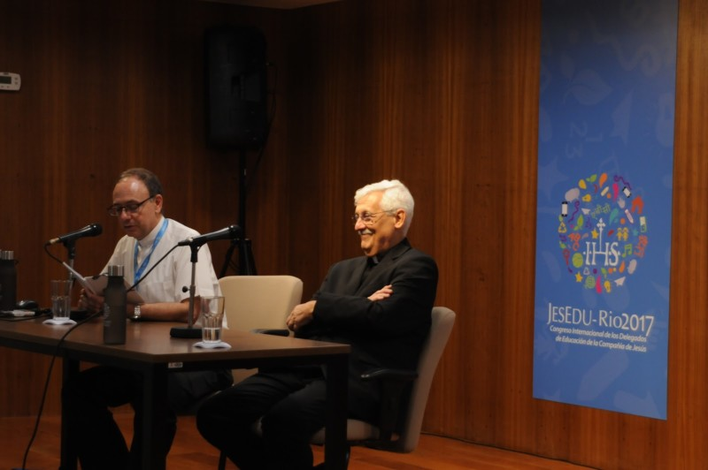
The Six Challenges of Fr General
Innovation in teaching
Progress in educating for justice
Care for ‘our common home’
A culture to protect minors
An experience of Christian faith
To think and act locally and globally

Slide 6
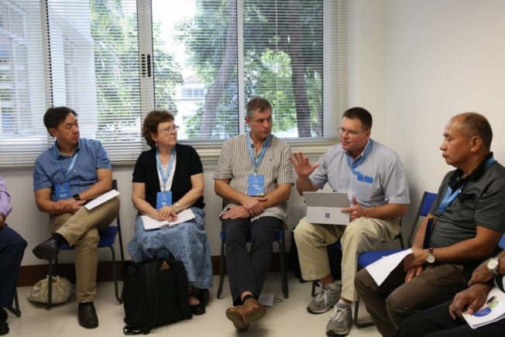
Through prayer, reflection, discussion and discernment, the delegates of the Congress responded to Fr General’s challenges and committed themselves, along with the schools they represent, to thirteen points of action . . .
The action points are an invitation and a challenge to every Jesuit school, worldwide, to take up and make part of their plans for development and renewal over the next five years, according to local needs and circumstances . . .

Slide 7
A. The Experience of God
1. The delegates commit to promote the Examen of Consciousness in each of the schools to help students listen to their inner voice and learn the path of interiority.
2. The delegates commit to work with the schools to ensure a module (or some such unit of the curriculum) of interreligious education is implemented. This module should allow students to learn about and from the world´s religions and respect the various ways religions express and celebrate the divine.
3. The delegates commit to find ways in which Ignatian spirituality (cf. the Spiritual Exercises) can be actively adapted to the school setting so that students learn the habit of stillness and the practice of discernment.

Slide 8
B. Tradition and Innovation
4. The delegates commit to engaging a process of Ignatian discernment that will lead to a plan of innovation for each school and a periodic review that corresponds to the local context and our tradition.
5. The delegates commit to reviewing with schools the traditional organizational structures and roles with a particular regard for gender stereotypes and gender inequalities.

Slide 9
B. Tradition and Innovation
6. The delegates commit to working with the schools to enhance the way parents and families are invited into our education and formation.
7. The delegates commit to urge the schools to reflect on the nature of human holistic excellence (the 4Cs*) so that academic success can be understood in its proper context. The delegates also commit to urge the schools to reflect on traditional notions of success and failure in the lives of our students.
*The 4Cs . . . “We aim to form leaders in service, in imitation of Christ Jesus, men and women of competence, conscience and compassionate commitment."
Peter-Hans Kolvenbach SJ
Address to Jesuit educators at Villa Cavalletti, Rome, 29th April 1993

Slide 10
C. Caring for Our Common Home
8. The delegates commit to promoting an environmental and social policy for each of our schools and to proposing ways regional networks can clearly integrate justice, faith, and care for the environment within the curricula of the schools highlighting critical thinking, political awareness, and social engagement – all to be reflected in classroom and school practices.
9. The delegates commit to ensuring that schools have a programme in place that allows students from marginalized and poor sectors of society to participate in a quality education and to ensuring that schools serving the marginalized and
poor reach beyond their experiences to build bridges with other people and communities.

Slide 11
D. Sent in a Global Network
10. The delegates commit, during their school visits and reviews, to assessing and developing the level of regional and global networking cooperation that exists.
11. The delegates commit to including in new faculty and staff training programmes an understanding that faculty and staff are joining a global network and that they have a role to play in animating it.

Slide 12
D. Sent in a Global Network
12. The delegates further commit to working with the schools´ leadership to oblige all faculty and staff be formed in global citizenship so that they can help students understand their future as global citizens.
13. The delegates commit to making Educate Magis an integral tool and resource in the schools to help animate their global dimension.

Slide 13
The Rio Papers
collects together resources from the Rio Congress:
1 An introduction to the Rio Congress
2 The thirteen Action Points of the Congress
3 Address of Fr General
4 Address of Pope Francis to Jesuit alumni
5 Questions for reflection, discussion and discernment
6 Guidance on implementing the Rio action points
7 Map of the worldwide network of Jesuit schools

